Slide 1
Remote Control Zumo Bot
Rostislav Martsenyak
&
Bin Phan

Slide 2
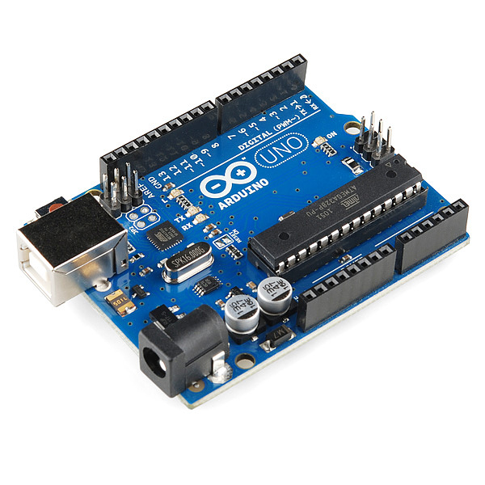
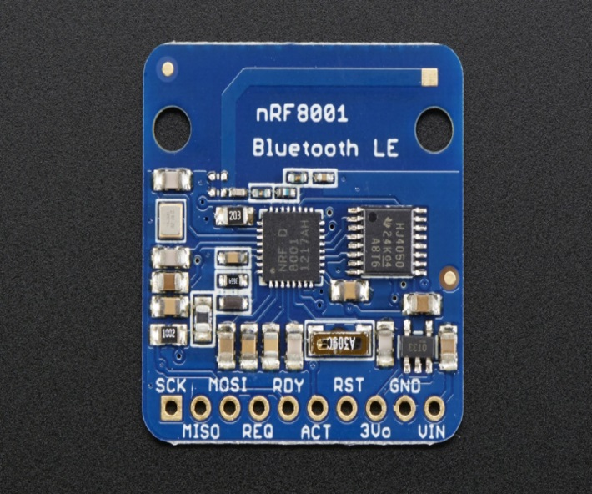
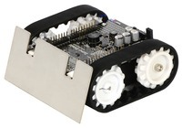
Parts Used
Zumo Bot
Bluefruit LE nRF8001
Arduino Uno R3

Slide 3
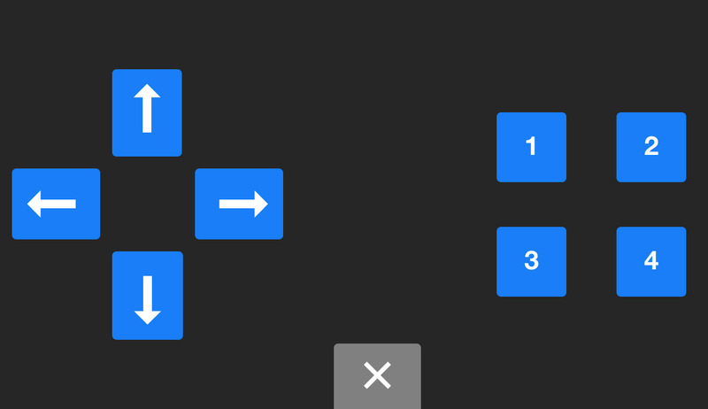
Project
Our goal was to control the zumo bot from our phones using the Bluefruit LE.
We achieved the goal and are able to move the Zumo bot up, down, left, and right from our phones using a control pad.

Slide 4

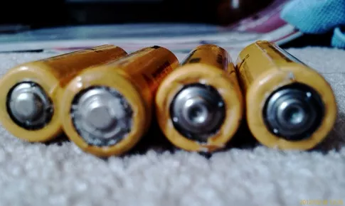

Things we learned
Solve the puzzle one piece at a time
Don’t have two power sources overlapping
Think outside the box
Have both people working on different bits of the puzzle

Slide 5

Things we learned
How Bluetooth chips work
How to pair things using a Bluetooth chip
The code required to make the communication work between the 3 devices

